Slide 1
File systems
Files
Directories & naming
File system implementation
Example file systems

Slide 2
Long-term information storage
Must store large amounts of data
  Gigabytes -> terabytes -> petabytes
Stored information must survive the termination of the process using it
  Lifetime can be seconds to years
  Must have some way of finding it!
Multiple processes must be able to access the information concurrently

Slide 3
Naming files
Important to be able to find files after they’re created
Every file has at least one name
Name can be
  Human-accessible: “foo.c”, “my photo”
  Machine-usable: 4502, 33481
Case may or may not matter Depends on the file system
Name may include information about the file’s contents
  Certainly does for the user
  Computer may use part of the name to determine the file type

Slide 4
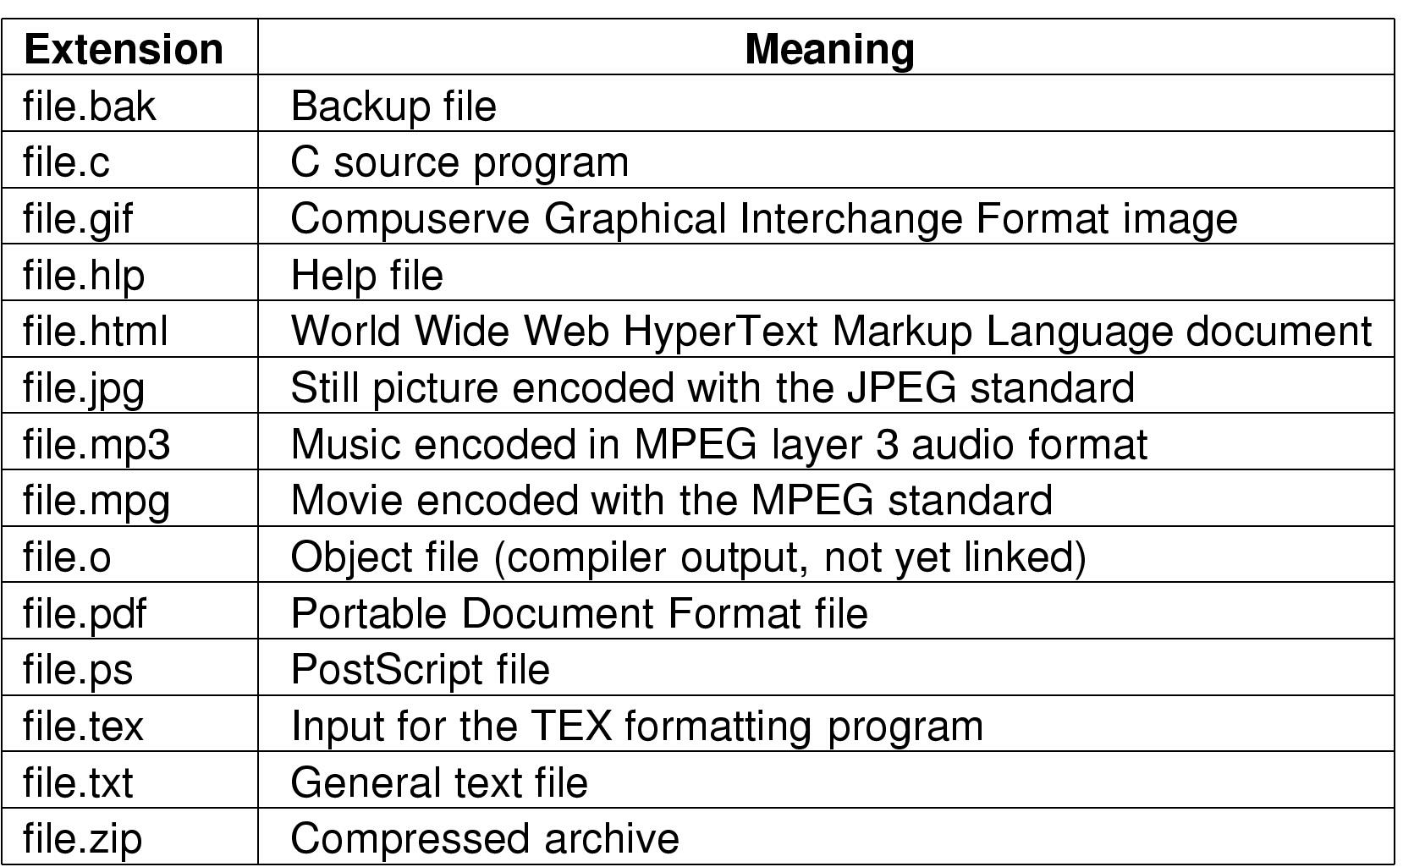
Typical file extensions

Slide 5
File structures
1 record
1 byte
12A
101
111
sab
wm
cm
avg
ejw
sab
elm
br
Sequence of bytes
Sequence of records
S02
F01
W02
Tree

Slide 6
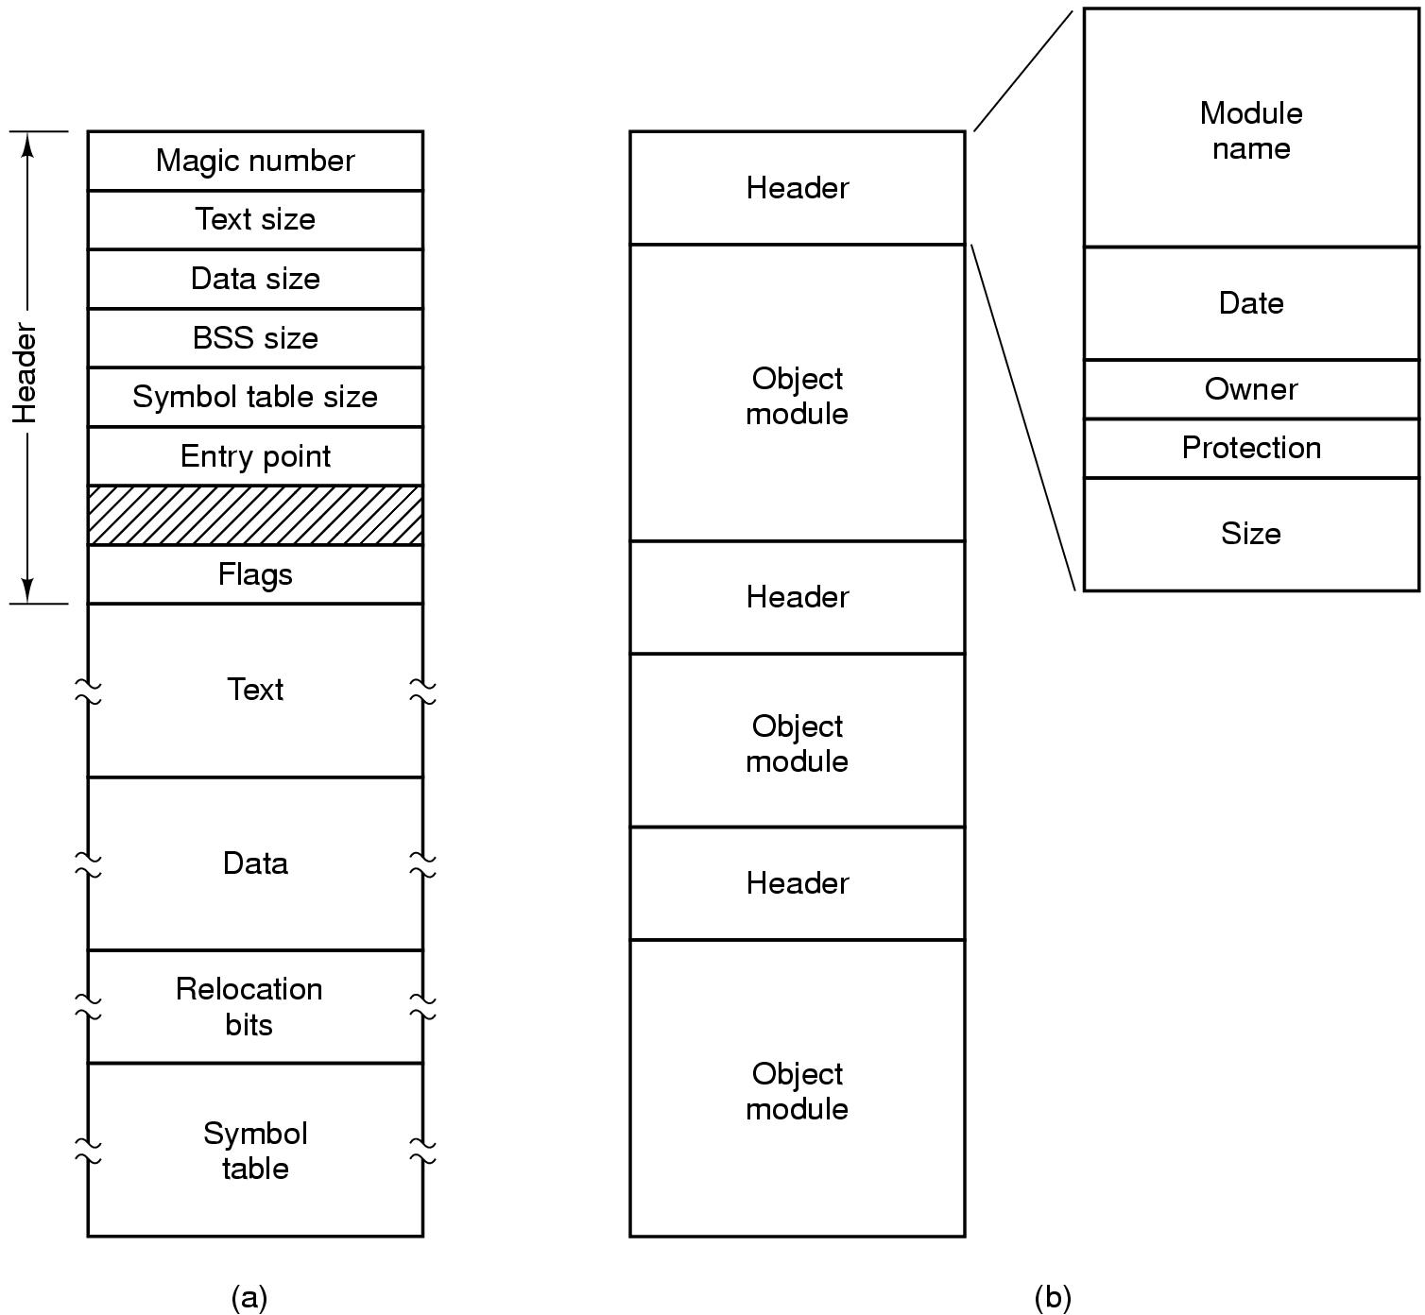
File types
Executable
file
Archive

Slide 7
Accessing a file
Sequential access
  Read all bytes/records from the beginning,Cannot jump around
    May rewind or back up, however
  Convenient when medium was magnetic tape
  Often useful when whole file is needed
Random access
  Bytes (or records) read in any order
  Essential for database systems

Slide 8
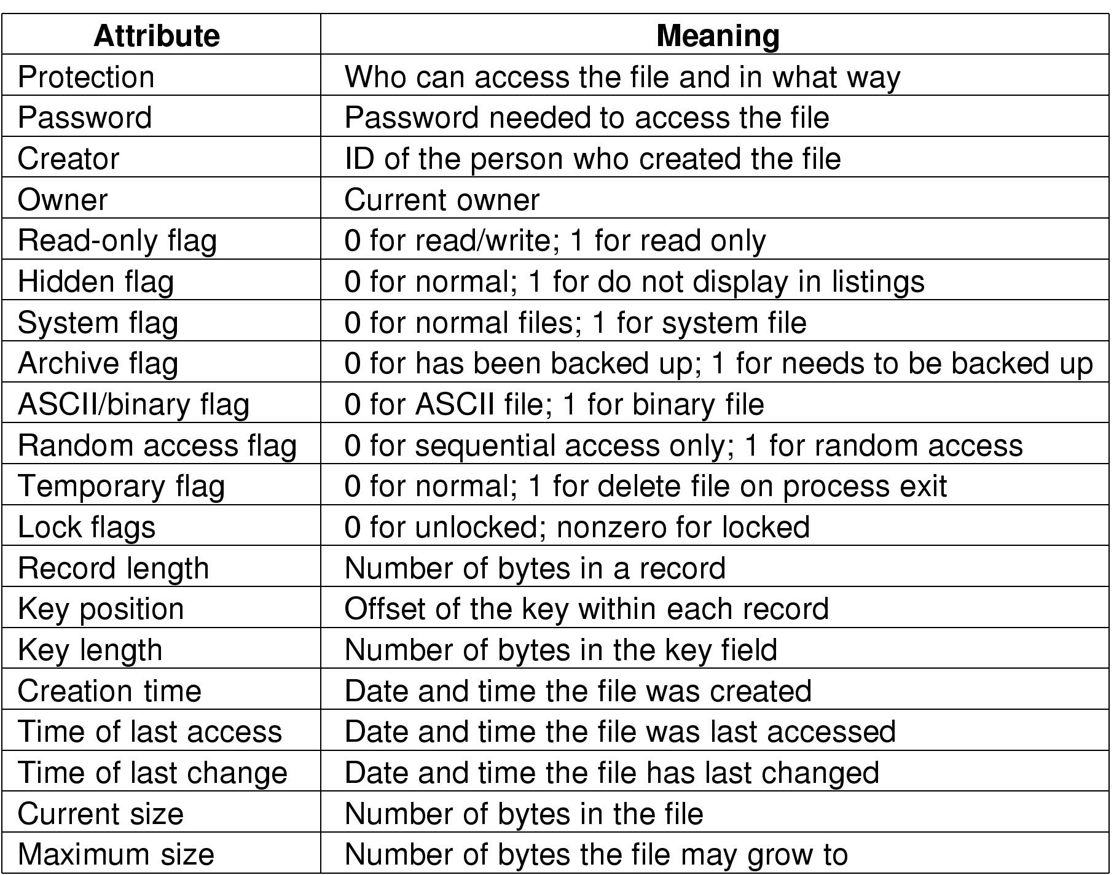
File attributes

Slide 9
File operations
Append: like write, but only at the end of the file
Seek: move the “current” pointer elsewhere in the file
Get attributes: retrieve attribute information
Set attributes: modify attribute information
Rename: change a file’s name
Create: make a new file
Delete: remove an existing file
Open: prepare a file to be accessed
Close: indicate that a file is no longer being accessed
Read: get data from a file
Write: put data to a file

Slide 10
Memory-mapped files
Program
text
Program
text
abc
Data
Data
xyz
Before mapping
After mapping
Segmented process before mapping files into its address space
Process after mapping
  Existing file abc into one segment
  Creating new segment for xyz

Slide 11
Directories
Naming is nice, but limited
Humans like to group things together for convenience
File systems allow this to be done with directories (sometimes called folders)
Grouping makes it easier to
  Find files in the first place: remember the enclosing directories for the file
  Locate related files (or just determine which files are related)

Slide 12
Attributes
Visible metadata for a Linux file
rwxrw-r-- 1 rama fac 2364 Apr 18 19:13 foo
  User permissions: rwx
  Group permissions: rw-
  Other permissions: r—
  Hard links: 1
  Owner: rama
  Group: fac
  Size: 2364
  Creation date and time: Apr 18 19:13
  File name: foo

Slide 13
Single-level directory systems
Root
directory
A
foo
A
bar
B
baz
C
blah
One directory in the file system
Example directory
  Contains 4 files (foo, bar, baz, blah)
  owned by 3 different people: A, B, and C (owners shown in red)
Problem: what if user B wants to create a file called foo?

Slide 14
Two-level directory system
Root
directory
A
B
C
A
foo
A
bar
B
foo
B
baz
C
bar
C
foo
C
blah
Solves naming problem: each user has her own directory
Multiple users can use the same file name
By default, users access files in their own directories
Extension: allow users to access files in others’ directories

Slide 15
Hierarchical directory system
Root
directory
A
B
C
A
Papers
A
foo
A
Photos
B
foo
B
Papers
C
bar
C
foo
C
blah
A
os.tex
A
sunset
A
Family
B
foo.tex
B
foo.ps
A
sunset
A
kids
A
Mom

Slide 16
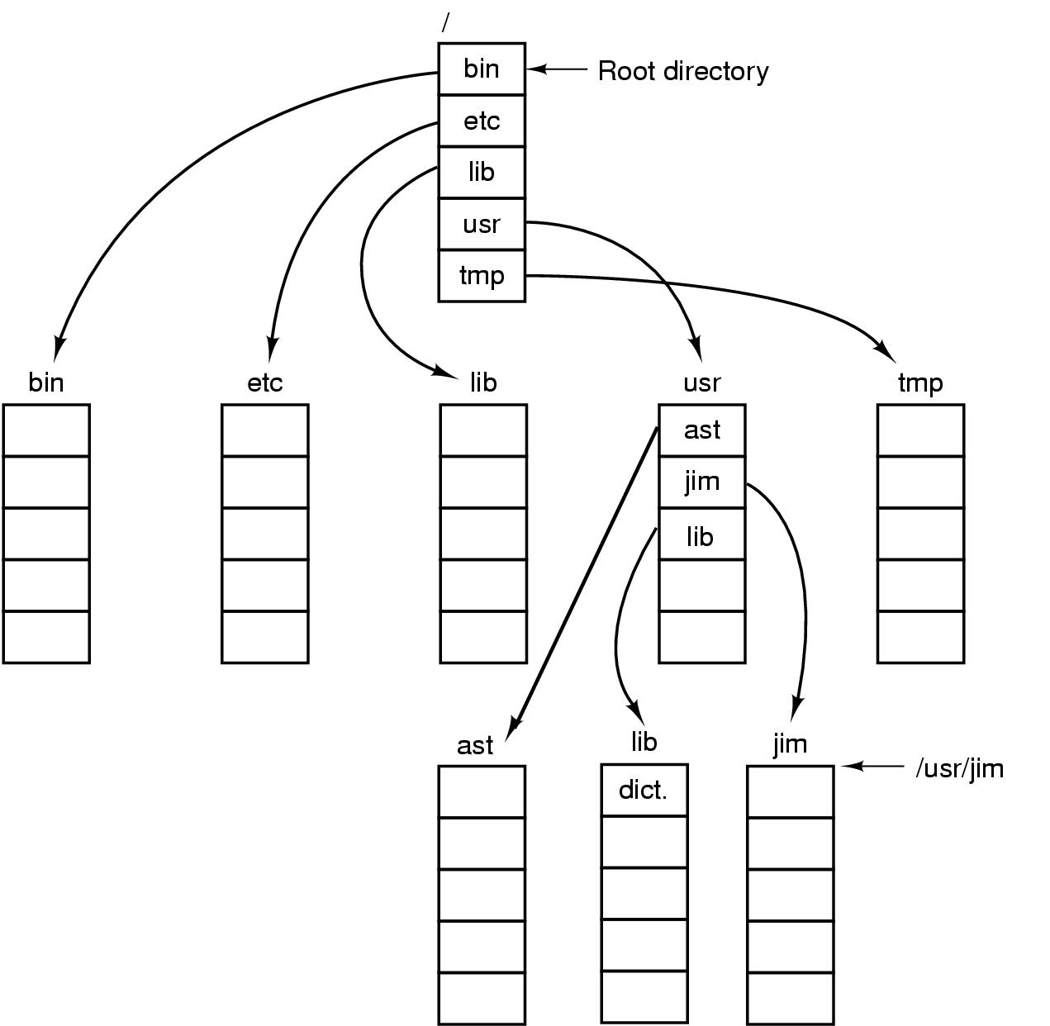
Unix directory tree

Slide 17
Operations on directories
Create: make a new directory
Delete: remove a directory (usually must be empty)
Opendir: open a directory to allow searching it
Closedir: close a directory (done searching)
Readdir: read a directory entry
Rename: change the name of a directory
Link: create a new entry in a directory to link to an existing file
Unlink: remove an entry in a directory
  Remove the file if this is the last link to this file

Slide 18
File system implementation issues
How are disks divided up into file systems?
How does the file system allocate blocks to files?
How does the file system manage free space?
How are directories handled?
How can the file system improve…
  Performance?
  Reliability?

Slide 19
Carving up the disk
Entire disk
Partition table
Master
boot record
Partition 1
Partition 2
Partition 3
Partition 4
Boot
block
Super
block
Free space
management
Index
nodes
Files & directories

Slide 20
Contiguous allocation for file blocks
A
B
C
D
E
F
A
Free
C
Free
E
F
Contiguous allocation requires all blocks of a file to be consecutive on disk
Problem: deleting files leaves “holes”
  Similar to memory allocation issues
  Compacting the disk can be a very slow procedure…

Slide 21
Data in each file is stored in consecutive blocks on disk
Simple & efficient indexing
  Starting location (block #) on disk (start)
  Length of the file in blocks (length)
Random access well-supported
Difficult to grow files
  Must pre-allocate all needed space
  Wasteful of storage if file isn’t using all of the space
Logical to physical mapping is easy
blocknum = (pos / 1024) + start;
offset_in_block = pos % 1024;

Slide 22
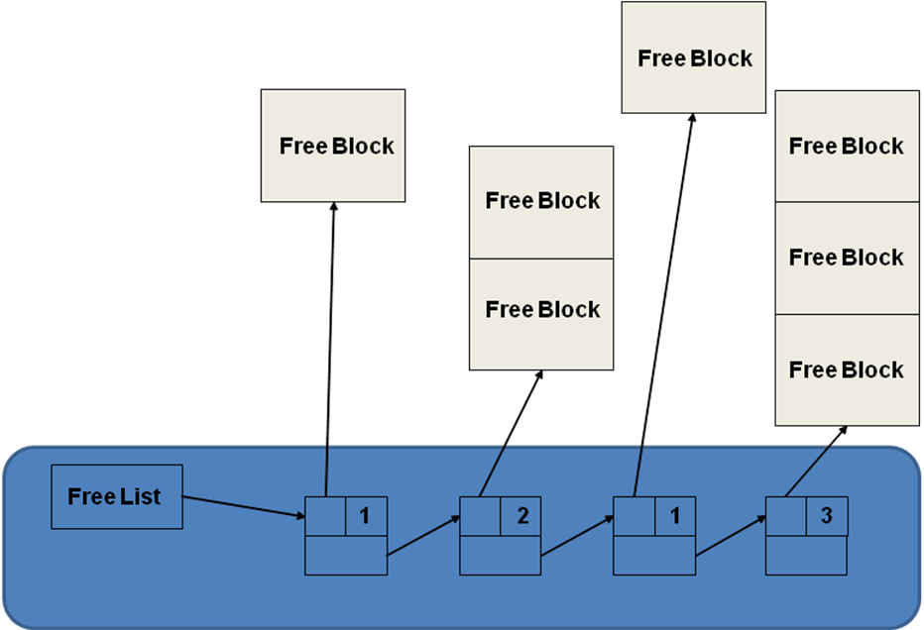
11.2.1 Contiguous Allocation
Free list
  Allocation may be by first or best fit
  Requires periodic compaction

Slide 23
11.2.2 Contiguous Allocation with Overflow Area
Modification of previous scheme to allow files to expand into a designated overflow area
Random access suffers due to overflow area
Despite limitations has been used extensively due to fast file access times

Slide 24
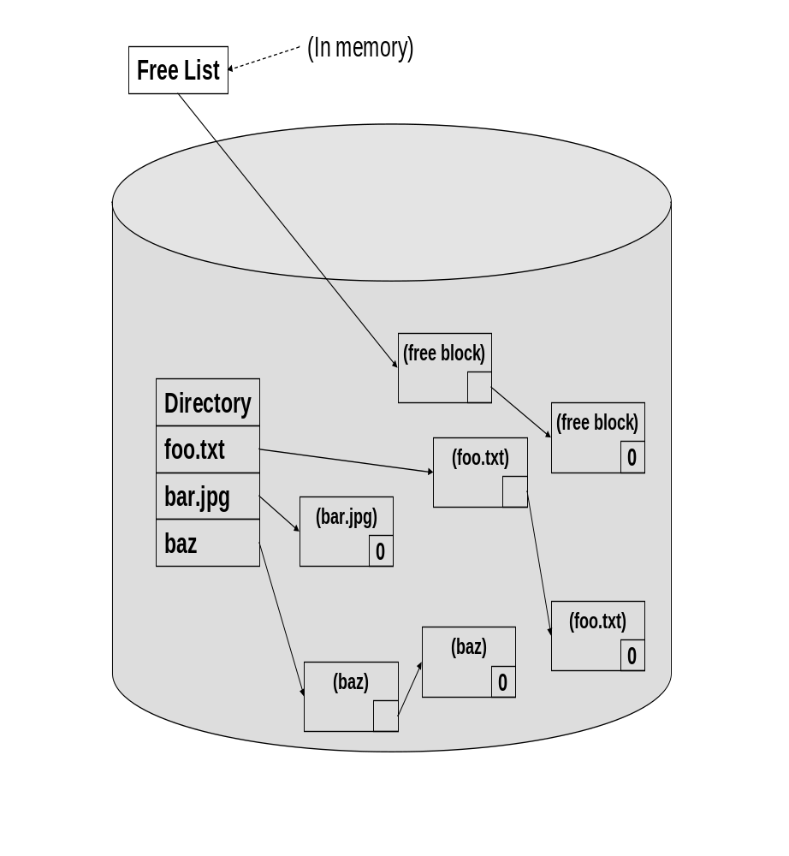
Linked Allocation
Files not stored contiguously
No compaction required
Sequential and random access poor
Susceptible to errors

Slide 25
File Allocation Table (FAT)
Directory
FAT
0
0
0
File name start index
30
1
70
0
/foo 30
.
.
50
1
-1
/bar 50
0
.
.
70
1
-1
Free/busy next

Slide 26
File Allocation Table (FAT)
Divide disk into partitions
Each partition has a FAT
The directory just has a pointer into the starting sector entry in the FAT for each file.
Less chance for errors than linked allocation
FAT becomes big so clustering and partitioning may be necessary leading to other problems

Slide 27
Indexed Allocation
Essentially breaks up FAT into one data structure per file
Allocate an index disk block for each file called an i-node
Directory entries now point to the i-node for that file
Maintain free list as bit vector

Slide 28
Indexed Allocation
Data blocks
Directory
i-node for /foo
100
30
100
File name i-node address
201
/foo 30
201
/bar 50
i-node for /bar
50
99
99

Slide 29
Indexed Allocation
Problem is that the one index file has to point to every possible size file.
Since the i-node is a fixed size there is a maximum file size

Slide 30
Multilevel Indexed Allocation
Make the i-node point to index blocks which point to the files (first-level indirection)
This concept may be extended to two-level (and beyond) indirection
Problem: Accessing even a small file requires a lot of indirection

Slide 31
Multilevel Indexed Allocation
Data blocks
Directory
100
i-node for /foo
1st level
File name i-node address
30
40
40
100
45
201
201
/foo 30
45
299
299

Slide 32
Hybrid Indexed Allocation
Combine the previous two concepts
  Two direct pointers for small files
  One single indirect
  One double indirect
  One triple indirect

Slide 33
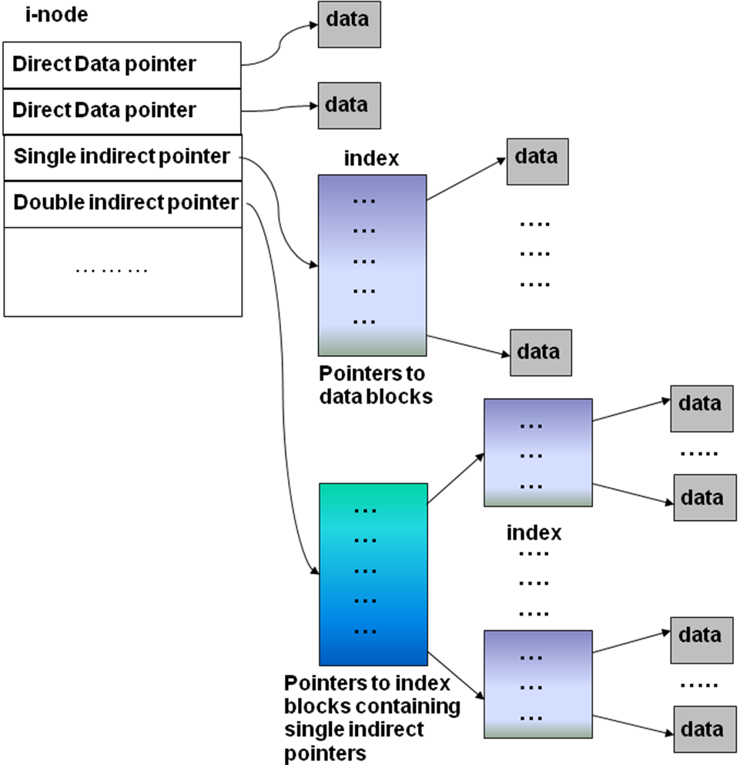
Hybrid Indexed Allocation

Slide 34
Hybrid Indexed Allocation
Data blocks
100
i-node for /foo
201
30
direct (100)
direct (201)
single indirect (40)
double indirect (45)
150
triple indirect
40
150
160
160
File
name
i-node
address
60
299
399
299
/foo 30
45
60
70
70
399
Directory

Slide 35
Given the following:
  Size of index block = 512 bytes
  Size of Data block = 2048 bytes
  Size of pointer = 8 bytes (to index or data blocks)
What is the maximum size (in bytes) of a file that can be stored in this file system?
How many data blocks are needed for storing a data file of 266 KB?
How many index blocks are needed for storing a data file of size 266 KB?

Slide 36
Contiguous allocation
0
1
2
3
4
5
6
7
8
9
10
11
Start=5
Length=2902

Slide 37
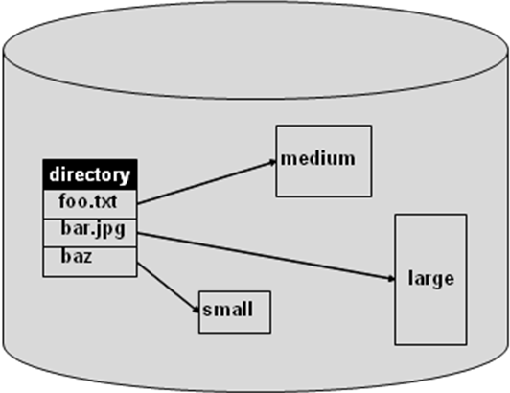
11.2.1 Contiguous Allocation
At file creation time a set amount of space is allocated (may depend on file type)
File cannot grow beyond that size
Fragmentation a problem

Slide 38
Linked allocation
File is a linked list of disk blocks
  Blocks may be scattered around the disk drive
  Block contains both pointer to next block and data
  Files may be as long as needed
New blocks are allocated as needed
  Linked into list of blocks in file
  Removed from list (bitmap) of free blocks
0
1
2
3
4
6
4
5
6
7
x
x
8
9
10
11
0
Start=9
End=4
Length=2902
Start=3
End=6
Length=1500

Slide 39
Finding blocks with linked allocation
Directory structure is simple
  Starting address looked up from directory
  Directory only keeps track of first block (not others)
No wasted space - all blocks can be used
Random access is difficult: must start at first block!
Logical to physical mapping is done by
block = start;
offset_in_block = pos % 1020;
for (j = 0; j < pos / 1020; j++) {
block = block->next; }

Slide 40
Linked allocation using a RAM-based table
0
4
Links on disk are slow
Keep linked list in memory
Advantage: faster
Disadvantages
  Have to copy it to disk at some point
  Have to keep in-memory and on-disk copy consistent
1
-1
2
-1
3
-2
4
-2
5
-1
6
3
B
7
-1
8
-1
9
0
A
10
-1
11
-1
12
-1
13
-1
14
-1
15
-1

Slide 41
Using a block index for allocation
Store file block addresses in an array
  Array itself is stored in a disk block
  Directory has a pointer to this disk block
  Non-existent blocks indicated by -1
Random access easy
Limit on file size?
Name index size
grades 4 4802
0
1
2
3
6
9
7
0
8
4
5
6
7
8
9
10
11

Slide 42
Finding blocks with indexed allocation
Need location of index table: look up in directory
look up block number in index table
Space utilization is good No wasted disk blocks
  Files can grow and shrink easily
  Overhead of a single disk block per file
Logical to physical mapping is done by
block = index[block % 1024];
offset_in_block = pos % 1024;
Limited file size: 256 pointers per index block, 1 KB per file block -> 256 KB per file limit

Slide 43
Larger files with indexed allocation
How can indexed allocation allow files larger than a single index block?
Linked index blocks: similar to linked file blocks, but using index blocks instead
Logical to physical mapping is done by
index = start;
blocknum = pos / 1024;
for (j = 0; j < blocknum /255); j++)

Slide 44
Larger files with indexed allocation
{
index = index->next;
}
block = index[blocknum % 255];
offset_in_block = pos % 1024;
File size is now unlimited
Random access slow, but only for very large files

Slide 45
What’s in a directory?
Two types of information
  File names
  File metadata (size, timestamps, etc.)
Basic choices for directory information
  Store all information in directory
    Fixed size entries
    Disk addresses and attributes in directory entry
  Store names & pointers to index nodes (i-nodes)

Slide 46
What’s in a directory?
attributes
games
attributes
games
attributes
mail
attributes
mail
news
attributes
news
attributes
research
attributes
research
attributes
Storing all information
in the directory
Using pointers to
index nodes

Slide 47
Directory structure
Structure
  Linear list of files (often itself stored in a file)
    Simple to program
    Slow to run
    Increase speed by keeping it sorted (insertions are slower!)
  Hash table: name hashed and looked up in file
    Decreases search time: no linear searches!
    May be difficult to expand

Slide 48
    Can result in collisions (two files hash to same location)
  Tree
    Fast for searching
    Easy to expand
    Difficult to do in on-disk directory
Name length
  Fixed: easy to program
  Variable: more flexible, better for users

Slide 49
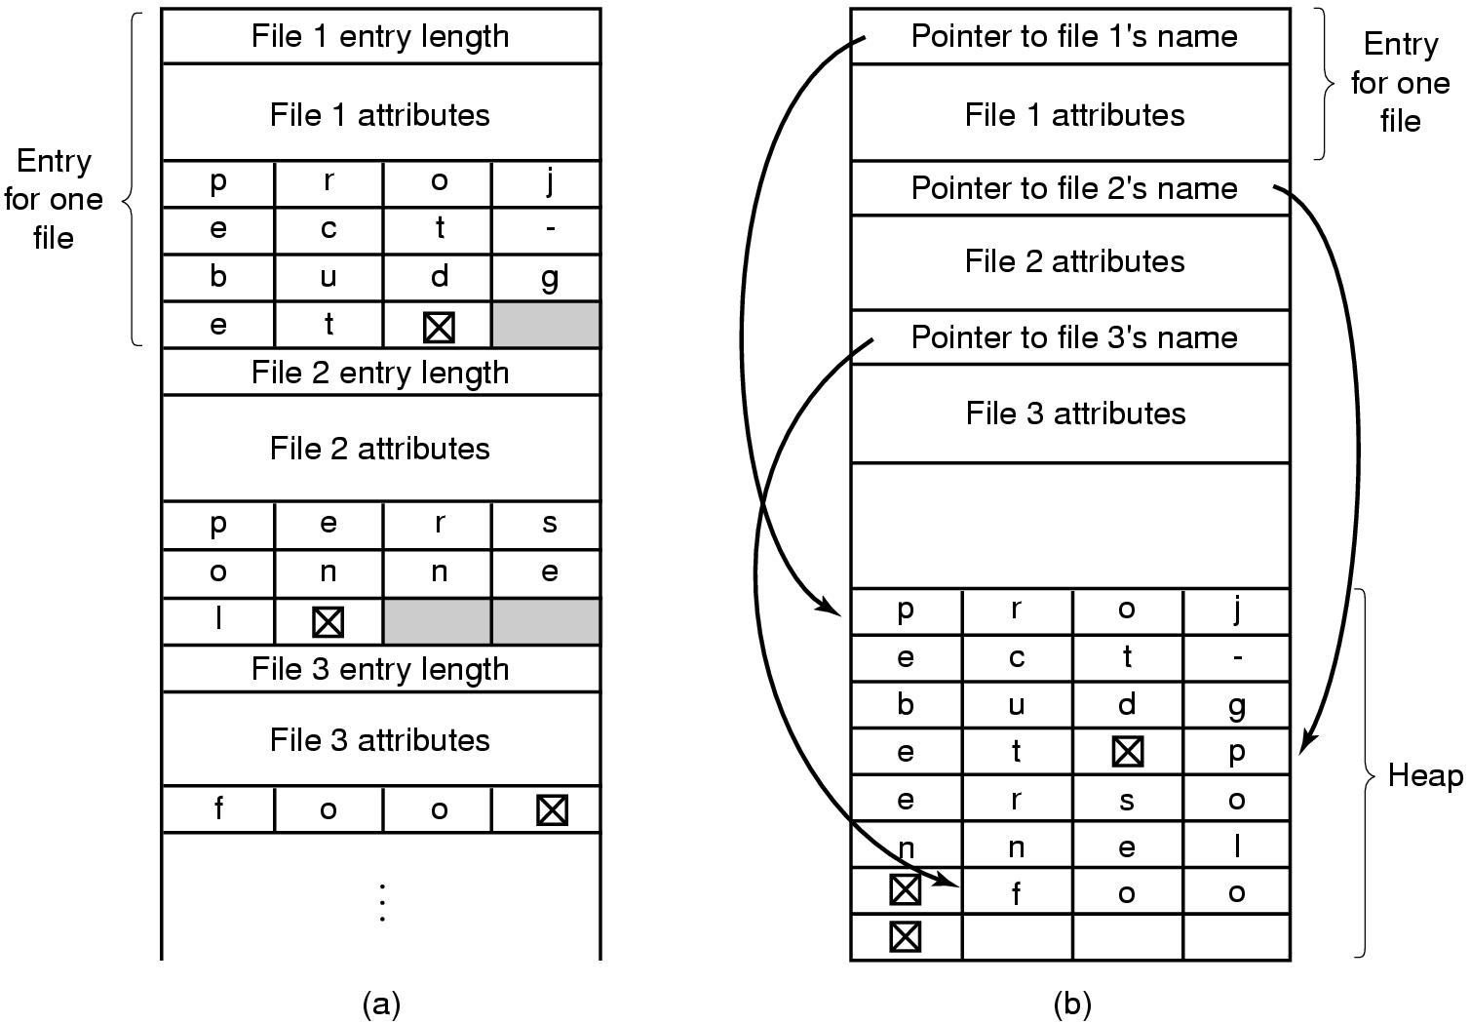
Handling long file names in a directory

Slide 50
Sharing files
Root
directory
A
B
C
A
Papers
A
foo
A
Photos
B
foo
B
Photos
C
bar
C
foo
C
blah
A
os.tex
A
sunset
A
Family
B
lake
A
sunset
A
kids
?
???

Slide 51
Solution: use links
A creates a file, and inserts into her directory
B shares the file by creating a link to it
A unlinks the file
  B still links to the file
  Owner is still A (unless B explicitly changes it)
A
A
B
B
b.tex
b.tex
a.tex
a.tex
Owner: A
Count: 1
Owner: A
Count: 2
Owner: A
Count: 1

Slide 52
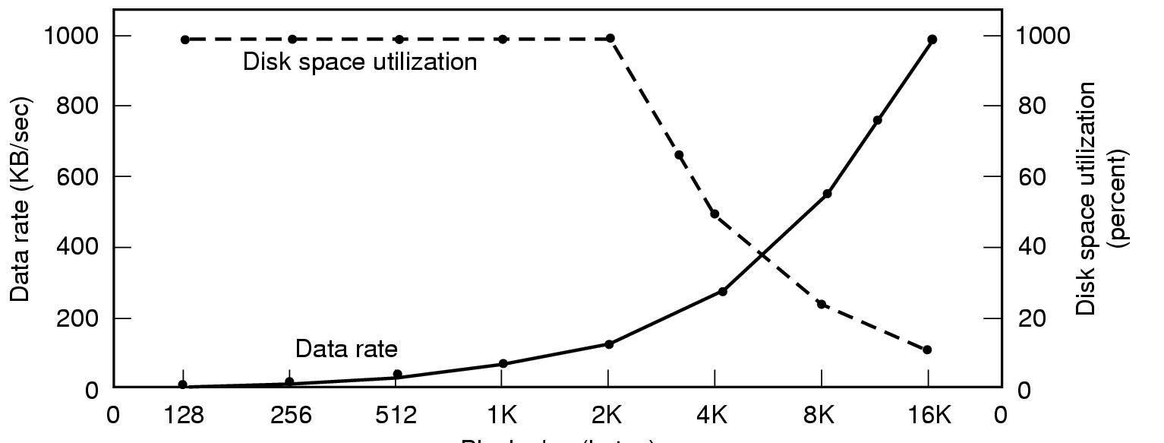
Managing disk space
Block size
Dark line (left hand scale) gives data rate of a disk
Dotted line (right hand scale) gives disk space efficiency
All files 2KB

Slide 53
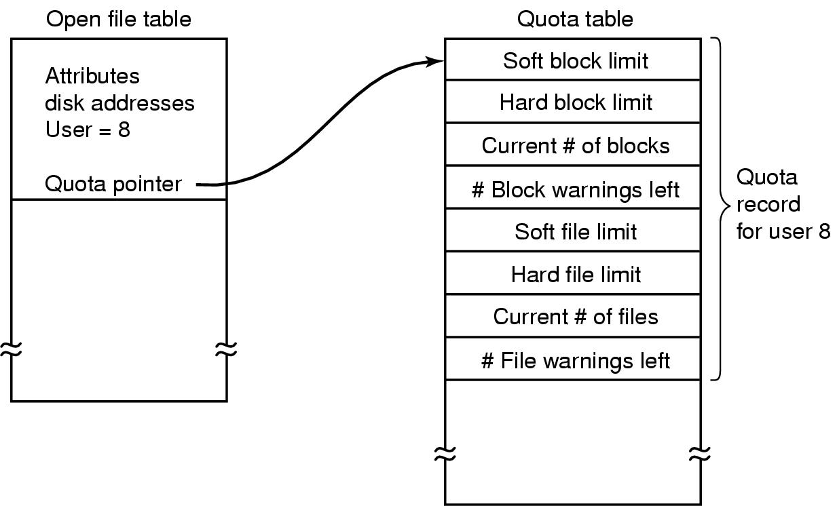
Disk quotas

Slide 54
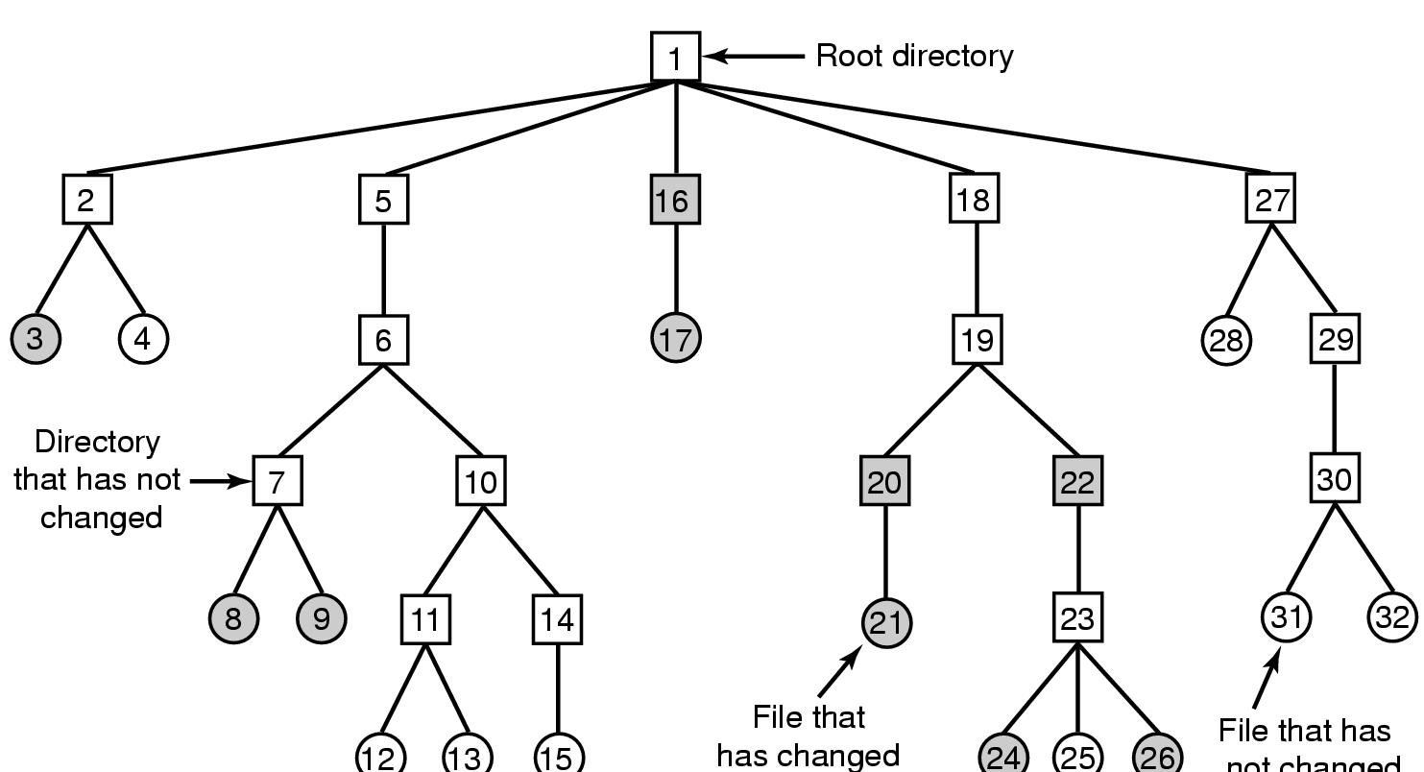
Backing up a file system
A file system to be dumped
  Squares are directories, circles are files
  Shaded items, modified since last dump
  Each directory & file labeled by i-node number
File that has
not changed

Slide 55
File system cache
Many files are used repeatedly
  Option: read it each time from disk
  Better: keep a copy in memory
File system cache
  Set of recently used file blocks
  Keep blocks just referenced
  Throw out old, unused blocks

Slide 56
File system cache
    Same kinds of algorithms as for virtual memory
    More effort per reference is OK: file references are a lot less frequent than memory references
Goal: eliminate as many disk accesses as possible!
  Repeated reads & writes
  Files deleted before they’re ever written to disk

Slide 57
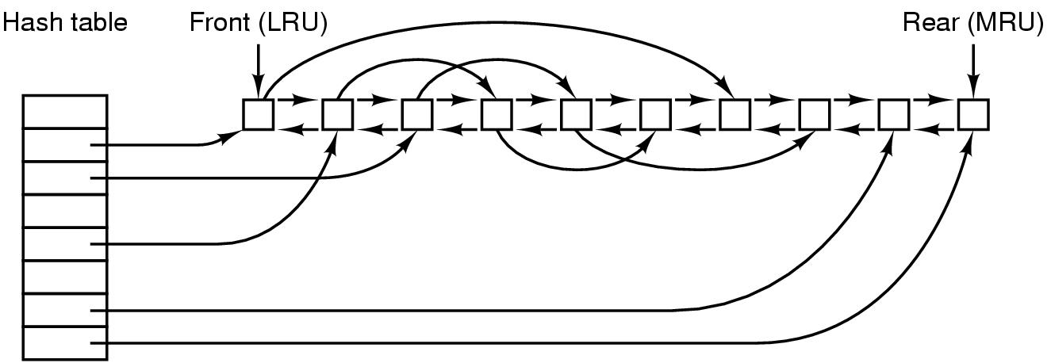
File block cache data structures

Slide 58

Grouping data on disk

Slide 59
Unix Fast File System indexing scheme
protection mode
data
owner & group
data
timestamps
.
.
.
size
data
block count
•
data
•
.
.
.
link count
•
Direct pointers
.
.
.
data
•
•
•
data
•
.
.
.
•
•
single indirect
•
•
data
double indirect
•
•
data
•
•
•
•
.
.
.
triple indirect
•
•
•
inode
•
•
•
data

Slide 60
More on Unix FFS
First few block pointers kept in directory
  Small files have no extra overhead for index blocks
  Reading & writing small files is very fast!
Indirect structures only allocated if needed
For 4 KB file blocks (common in Unix), max file sizes are:
  48 KB in directory (usually 12 direct blocks)
  1024 * 4 KB = 4 MB of additional file data for single indirect

Slide 61
More on Unix FFS
  1024 * 1024 * 4 KB = 4 GB of additional file data for double indirect
  1024 * 1024 * 1024 * 4 KB = 4 TB for triple indirect
Maximum of 5 accesses for any file block on disk
  1 access to read inode & 1 to read file block
  Maximum of 3 accesses to index blocks
  Usually much fewer (1-2) because inode in memory

Slide 62
Directories in FFS
Directory
Directories in FFS are just special files
  Same basic mechanisms
  Different internal structure
Directory entries contain
  File name
  I-node number
Other Unix file systems have more complex schemes
  Not always simple files…
inode number
record length
name length
name
inode number
record length
name length
name

Slide 63
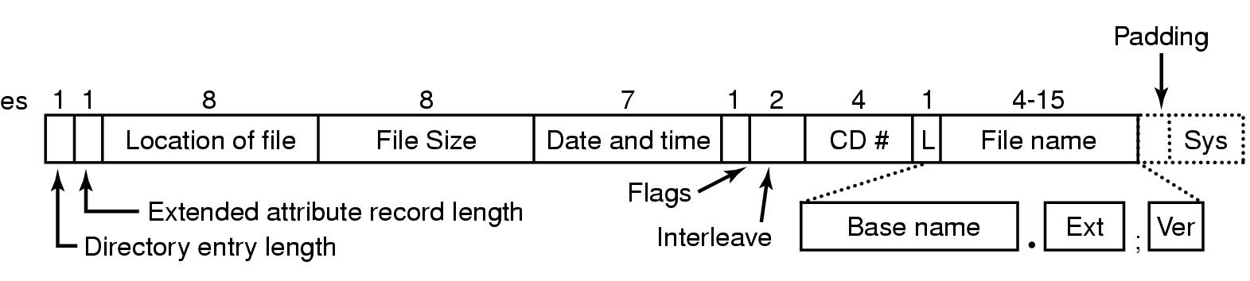
CD-ROM file system

Slide 64
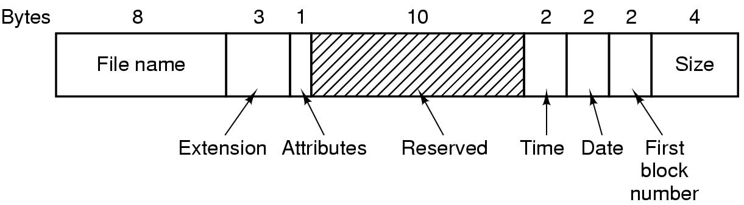
Directory entry in MS-DOS

Slide 65
MS-DOS File Allocation Table
Block size | FAT-12 | FAT-16 | FAT-32
0.5 KB | 2 MB
1 KB | 4 MB
2 KB | 8 MB | 128 MB
4 KB | 16 MB | 256 MB | 1 TB
8 KB |  | 512 MB | 2 TB
16 KB |  | 1024 MB | 2 TB
32 KB |  | 2048 MB | 2 TB

Slide 66
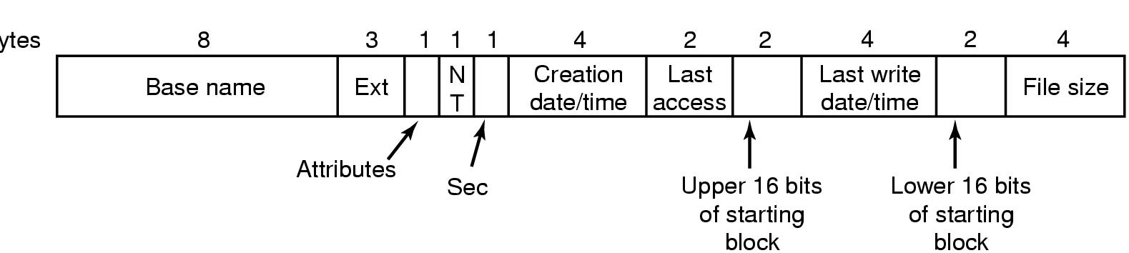
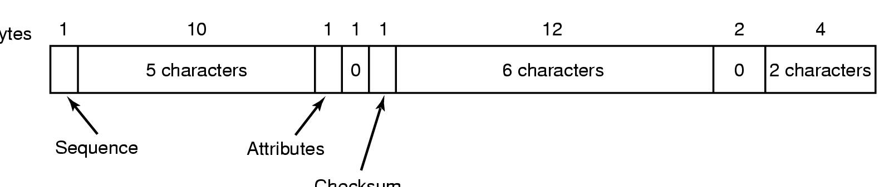
Windows 98 directory entry & file name
Bytes
Checksum

Slide 67
Input-output system calls in C | Create, Open, Close, Read, Write
What is the File Descripter??
File descriptor is integer that uniquely identifies an open file of the process.
File Descriptor table: File descriptor table is the collection of integer array indices that are file descriptors in which elements are pointers to file table entries.
One unique file descriptors table is provided in operating system for each process.

Slide 68
File Table Entry: File table entries is a structure In-memory surrogate for an open file, which is created when process request to opens file and these entries maintains file position.
Standard File Descriptors: When any process starts, then that process file descriptors table’s fd(file descriptor) 0, 1, 2 open automatically, (By default) each of these 3 fd references file table entry for a file named /dev/tty
/dev/tty: In-memory surrogate for the terminal
Terminal: Combination keyboard/video screen

Slide 69
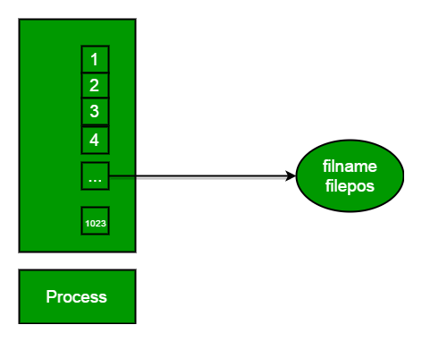
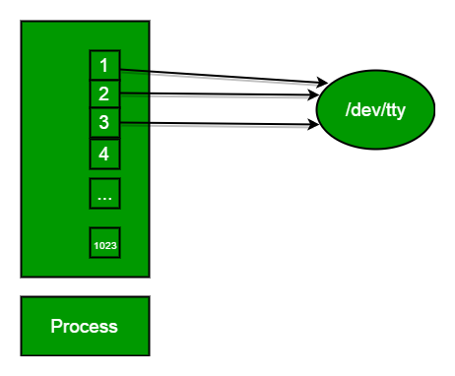

Slide 70
Read from stdin => read from fd 0 : Whenever we write any character from keyboard, it read from stdin through fd 0 and save to file named /dev/tty.
Write to stdout => write to fd 1 : Whenever we see any output to the video screen, it’s from the file named /dev/tty and written to stdout in screen through fd 1.
Write to stderr => write to fd 2 : We see any error to the video screen, it is also from that file write to stderr in screen through fd 2.

Slide 71
I/O System calls
Basically there are total 5 types of I/O system calls:
Create: Used to Create a new empty file.

Slide 72
Create: Used to Create a new empty file.
Syntax in C language:
int create(char *filename, mode_t mode)
Parameter :
filename : name of the file which you want to create
mode : indicates permissions of new file.
Returns :
return first unused file descriptor (generally 3 when first create use in process as 0, 1, 2 fd are reserved)
return -1 when error

Slide 73
How it work in OS
Create new empty file on disk
Create file table entry
Set first unused file descriptor to point to file table entry
Return file descriptor used, -1 upon failure

Slide 74
open: Used to Open the file for reading, writing or both.
Syntax in C language
  #include<sys/types.h>
  #includ<sys/stat.h>
  #include <fcntl.h>
  int open (const char* Path, int flags [, int mode ]);
Parameters
Path : path to file which you want to use

Slide 75
use absolute path begin with “/”, when you are not work in same directory of file.
Use relative path which is only file name with extension, when you are work in same directory of file.
flags : How you like to use
O_RDONLY: read only, O_WRONLY: write only, O_RDWR: read and write, O_CREAT: create file if it doesn’t exist, O_EXCL: prevent creation if it already exists

Slide 76
How it works in OS
Find existing file on disk
Create file table entry
Set first unused file descriptor to point to file table entry
Return file descriptor used, -1 upon failure
filter_n

Slide 77
// C program to illustrate open system call
#include<stdio.h>
#include<fcntl.h>
#include<errno.h>
extern int errno;
int main()
{
// if file does not have in directory, file foo.txt is created.
int fd = open("foo.txt", O_RDONLY | O_CREAT);
printf("fd = %d/n", fd);

Slide 78
if (fd ==-1)
{
// print which type of error have in a code
printf("Error Number % d\n", errno);
// print program detail "Success or failure"
perror("Program");
}
return 0;
}

Slide 79
close: Tells the OS system you are done with a fd & Close the file pointed by fd.
Syntax in C language
#include <fcntl.h>
int close(int fd);
Parameter
fd :file descriptor
Return
0 on success.
-1 on error.

Slide 80
How it works in the OS
Destroy file table entry referenced by element fd of file descriptor table
– As long as no other process is pointing to it!
Set element fd of file descriptor table to NULL
filter_none

Slide 81
// C program to illustrate close system Call
#include<stdio.h>
#include <fcntl.h>
int main()
{
int fd1 = open("foo.txt", O_RDONLY);
if (fd1 < 0)
{ perror("c1");
exit(1); }

Slide 82
printf("opened the fd = % d\n", fd1);
// Using close system Call
if (close(fd1) < 0)
{
perror("c1");
exit(1);
}
printf("closed the fd.\n");
}

Slide 83
// C program to illustrate close system Call
#include<stdio.h>
#include<fcntl.h>
int main()
{
// assume that foo.txt is already created
int fd1 = open("foo.txt", O_RDONLY, 0);
close(fd1);

Slide 84
// assume that baz.tzt is already created
int fd2 = open("baz.txt", O_RDONLY, 0);
printf("fd2 = % d\n", fd2);
exit(0);
}

Slide 85
Here, In this code first open() returns 3 because when main process created, then fd 0, 1, 2 are already taken by stdin, stdout and stderr.
So first unused file descriptor is 3 in file descriptor table.
After that in close() system call is free it this 3 file descriptor and then after set 3 file descriptor as null.
So when we called second open(), then first unused fd is also 3. So, output of this program is 3.

Slide 86
read: From the file indicated by fd, the read() function reads cnt bytes of input into the memory area indicated by buf.
A successful read() updates the access time for the file.
Syntax in C language
size_t read (int fd, void* buf, size_t cnt);

Slide 87
Parameters
fd: file descripter
buf: buffer to read data from
cnt: length of buffer
Returns: How many bytes were actually read
return Number of bytes read on success
return 0 on reaching end of file
return -1 on error
return -1 on signal interrupt

Slide 88
Important points
buf needs to point to a valid memory location with length not less than specified size because of overflow.
fd should be a valid file descriptor returned from open() to perform read operation because if fd is NULL then read should generate error.
cnt is the requested number of bytes read, while the return value is the actual number of bytes read.
Also, some times read system call should read less bytes than cnt.

Slide 89
// C program to illustrate read system Call
#include<stdio.h>
#include <fcntl.h>
int main()
{
int fd, sz;
char *c = (char *) calloc(100, sizeof(char));
fd = open("foo.txt", O_RDONLY);
if (fd < 0) { perror("r1"); exit(1);
}

Slide 90
sz = read(fd, c, 10);
printf("called read(% d, c, 10). returned that"
" %d bytes were read.\n", fd, sz);
c[sz] = '\0';
printf("Those bytes are as follows: % s\n", c);
}

Slide 91
Suppose that foobar.txt consists of the 6 ASCII characters “foobar”. Then what is the o/p of the program?
// C program to illustrate read system Call
#include<stdio.h>
#include<fcntl.h>
int main()
{
char c;
int fd1 = Open("foobar.txt", O_RDONLY, 0);
int fd2 = Open("foobar.txt", O_RDONLY, 0);

Slide 92
Read(fd1, &c, 1); Read(fd2, &c, 1);
printf("c = % c\n", c);
exit(0);
}
Output:
c = f
The descriptors fd1 and fd2 each have their own open file table entry, so each descriptor has its own file position for foobar.txt.
Thus, the read from fd2 reads the first byte of foobar.txt, and the output is c = f, not c = o.

Slide 93
write: Writes cnt bytes from buf to the file or socket associated with fd. cnt should not be greater than INT_MAX (defined in the limits.h header file).
If cnt is zero, write() simply returns 0 without attempting any other action.
#include <fcntl.h>
size_t write (int fd, void* buf, size_t cnt);

Slide 94
Parameters
fd: file descripter
buf: buffer to write data to
cnt: length of buffer
Returns: How many bytes were actually written
return Number of bytes written on success
return 0 on reaching end of file
return -1 on error
return -1 on signal interrupt

Slide 95
Important points
The file needs to be opened for write operations
buf needs to be at least as long as specified by cnt because if buf size less than the cnt then buf will lead to the overflow condition.
cnt is the requested number of bytes to write, while the return value is the actual number of bytes written.
This happens when fd have a less number of bytes to write than cnt.

Slide 96
If write() is interrupted by a signal, the effect is one of the following:
-If write() has not written any data yet, it returns -1 and sets errno to EINTR.
-If write() has successfully written some data, it returns the number of bytes it wrote before it was interrupted.

Slide 97
// C program to illustrate write system Call
#include<stdio.h>
#include <fcntl.h>
main()
{
int sz;
int fd = open("foo.txt", O_WRONLY | O_CREAT | O_TRUNC, 0644);

Slide 98
if (fd < 0)
{
perror("r1");
exit(1);
}
sz = write(fd, "hello world \n", strlen("hello world\n"));
printf("called write(% d, \"hello world \\n\", %d)."
" It returned %d\n", fd, strlen("hello world\n"), sz);
close(fd);
}

Slide 99
Here, when you see in the file foo.txt after running the code, you get a “hello world“.
If foo.txt file already have some content in it then write system call overwrite the content and all previous content are deleted and only “hello world” content will have in the file.

Slide 100
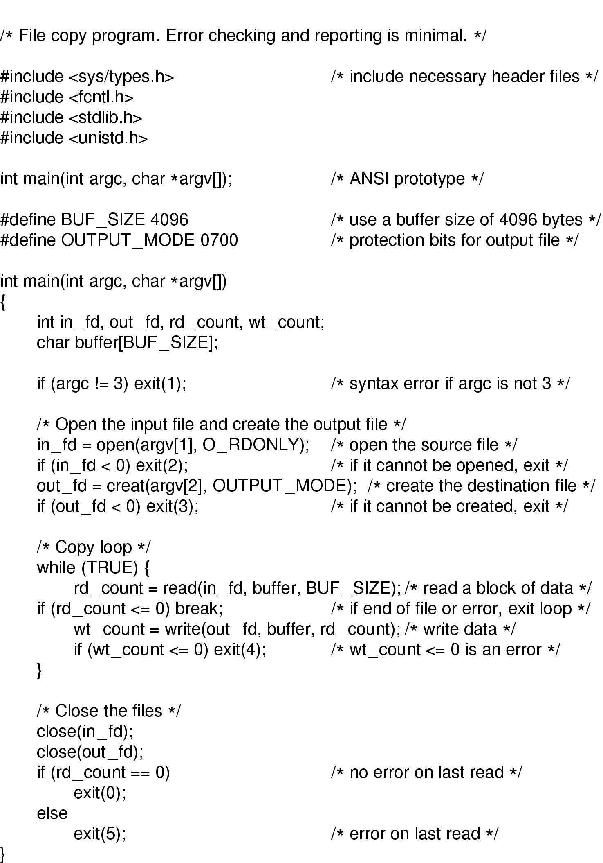

Slide 102
Print “hello world” from the program without use any printf or cout function.

Slide 103
// C program to illustrate I/O system Calls
#include<stdio.h>
#include<string.h>
#include<unistd.h>
#include<fcntl.h>
int main (void)
{
int fd[2];
char buf1[12] = "hello world";
char buf2[12];

Slide 104
// assume foobar.txt is already created
fd[0] = open("foobar.txt", O_RDWR);
fd[1] = open("foobar.txt", O_RDWR);
write(fd[0], buf1, strlen(buf1));
write(1, buf2, read(fd[1], buf2, 12));
close(fd[0]);
close(fd[1]);
return 0;
}

Slide 105
Output:
hello world
In this code, buf1 array’s string “hello world” is first write in to stdin fd[0] then after that this string write into stdin to buf2 array.
After that write into buf2 array to the stdout and print output “hello world“.

